Slide 1
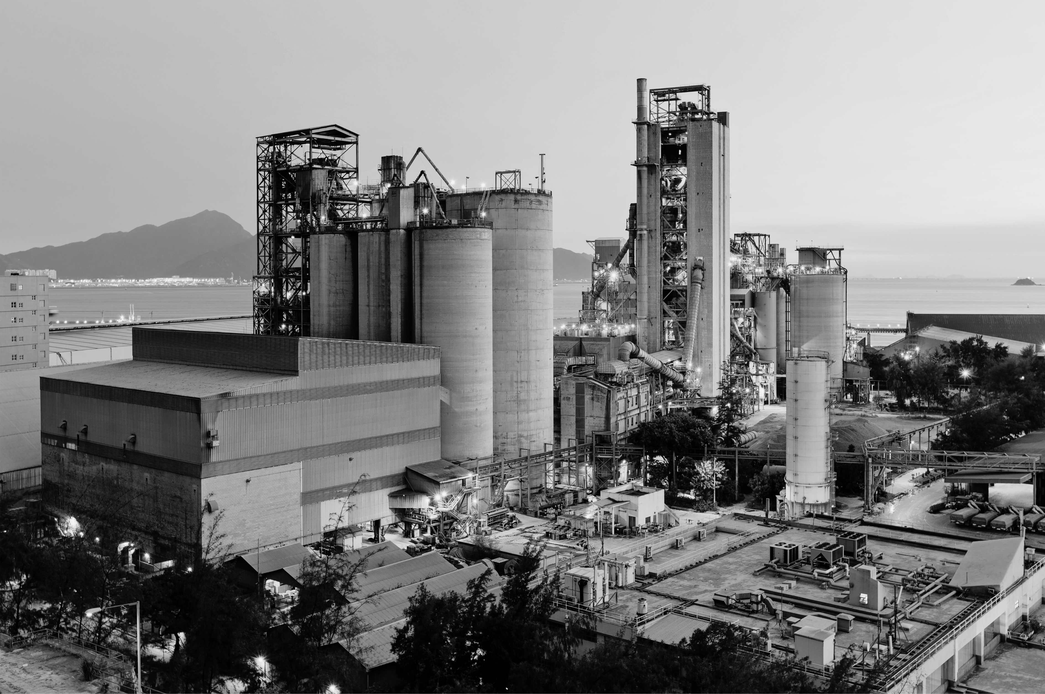


AUSTIN
INDUSTRIAL REPORT
Q1 2025
Franklin Street Data & Research

Slide 2






INDUSTRIAL REPORT | AUSTIN | Q1 2025
Outlook
Austin’s industrial vacancy rate has climbed to a decade-high of 12.0%, driven by record levels of big-box distribution center development, according to CoStar. Over the past two years, deliveries have consistently outpaced absorption, placing upward pressure on vacancy and limiting rent growth. CoStar data highlights that the most significant contributor to this trend is the surge in construction of facilities ranging from 100,000 to 500,000 SF, which make up roughly half of the current development pipeline. In contrast, warehouses under 100,000 SF account for just 20% of ongoing development. Despite rising vacancies, demand remains supported by Austin’s strong population growth, steady housing construction, and resilient retail sales, along with several large-scale owner-occupied projects.
YOY Trends
Absorption & Deliveries
12%
Vacancy Rate
15M
Under Construction SF
$14.25
Market Rent/SF
6.3M
12 MO Net Absorption SF
Under Construction
Sales Volume
Franklin Street Data & Research
2025 Franklin Street

Slide 3
INDUSTRIAL REPORT | AUSTIN | Q1 2025
Market Asking Rent & Growth
Job Growth
Population Growth
Median Household Income & Growth
Franklin Street Data & Research
2025 Franklin Street

Slide 4
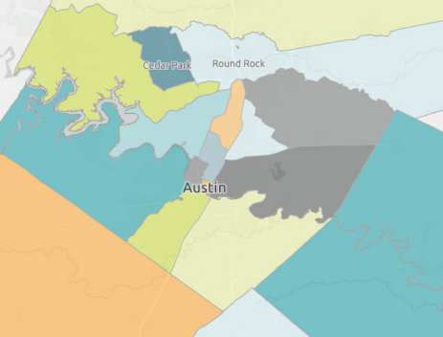

INDUSTRIAL REPORT | AUSTIN | Q1 2025
Our Team
MARSHALL DURRETT Managing Director
Industrial & Land Investment Sales
Marshall.Durrett@FranklinSt.com
P: 512.316.7866
ALEX RAMOS
Business Data Analyst Alex.Ramos@FranklinSt.com
P: 813.839.7300
Georgetown
Cedar Park
Round Rock
North
Far Northeast
LAURA FRETWELL
Senior Associate
Industrial & Land Investment Sales
Laura.Fretwell@FranklinSt.com
P: 512.316.7866
Southwest
Northeast
East
South
Southeast
Hays County
KELLY ANTINI
Research Analyst
Kelly.Antini@FranklinSt.com
P: 813.839.7300
Source: CoStar
Disclaimer:
Franklin Street, together with its subsidiaries or affiliates, reserves all rights contained in this report. This report is gathered from purported reliable multiple third-party and independent sources for the purposes of providing information to the public as a whole. It is not intended to reflect, nor does it represent, any warranties, representations or accuracies within any data or information and may, in fact, contain errors or incomplete information. Any views expressed in this report are subject to change with or without notice. Any advice provided to clients by Franklin Street may reflect different opinions based upon the unique and independent client circumstances to a given transaction or service. Franklin Street does not suggest, and expressly disclaims, reliance on investment or other business decisions made solely upon the information contained in this report.
https://franklinst.com/
Franklin Street Data & Research
2025 Franklin Street

Slide 5
ATLANTA
INDUSTRIAL REPORT
Q1 2025
Franklin Street Data & Research

Slide 6
INDUSTRIAL REPORT | ATLANTA | Q1 2025
Outlook
The Atlanta industrial market has experienced a marked slowdown over the past year, following several years of heightened activity. According to CoStar, the metro’s vacancy rate has risen to 8.0% as new deliveries have consistently outpaced net absorption. Quarterly demand has remained muted, and the influx of newly completed big-box spaces is expected to push vacancies even higher in the near term. CoStar forecasts that a tapering of development activity will begin to rebalance the market, setting the stage for tighter vacancies and a potential rebound in rent growth by late 2025.
YOY Trends
Absorption & Deliveries
8.0%
Vacancy Rate
18.3M
Under Construction SF
$9.79
Market Rent/SF
4.5M
12 MO Net Absorption SF
Under Construction
Sales Volume
Franklin Street Data & Research
2025 Franklin Street

Slide 7
INDUSTRIAL REPORT | ATLANTA | Q1 2025
Market Asking Rent & Growth
Job Growth
Population Growth
Median Household Income & Growth
Franklin Street Data & Research
2025 Franklin Street

Slide 8
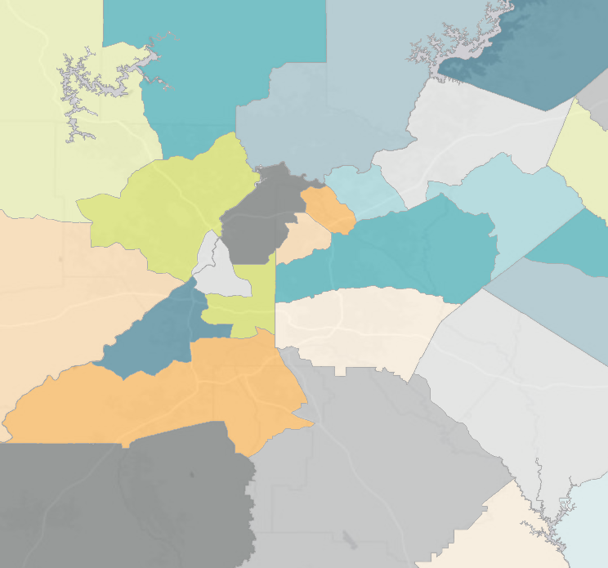
INDUSTRIAL REPORT | ATLANTA | Q1 2025
Our Team
CHARLES PERRY Senior Director
Industrial & Land Services
Charles.Perry@FranklinSt.com
P: 404.832.1250
ALEX RAMOS
Business Data Analyst Alex.Ramos@FranklinSt.com
P: 813.839.7300
Woodstock/
Canton
I-985/
Gainesville
Kennesaw/
Acworth
N Fulton/
Forsyth County
Duluth/
Buford
SE Cobb County/
Marietta
CHRISTOPHER WELSH
Senior Associate
Industrial Leasing Services Christopher.Welsh@FranklinSt.com
P: 404.832.1250
I-20 W/
Douglasville
Snapfinger
Airport/
North Clayton
Rockdale/
Newton County
KELLY ANTINI
Research Analyst
Kelly.Antini@FranklinSt.com
P: 813.839.7300
Fayette/
Coweta County
S Clayton/
Henry County
Source: CoStar
Disclaimer:
Franklin Street, together with its subsidiaries or affiliates, reserves all rights contained in this report. This report is gathered from purported reliable multiple third-party and independent sources for the purposes of providing information to the public as a whole. It is not intended to reflect, nor does it represent, any warranties, representations or accuracies within any data or information and may, in fact, contain errors or incomplete information. Any views expressed in this report are subject to change with or without notice. Any advice provided to clients by Franklin Street may reflect different opinions based upon the unique and independent client circumstances to a given transaction or service. Franklin Street does not suggest, and expressly disclaims, reliance on investment or other business decisions made solely upon the information contained in this report.
https://franklinst.com/
Franklin Street Data & Research
2025 Franklin Street

Slide 9
JACKSONVILLE
INDUSTRIAL REPORT
Q1 2025
Franklin Street Data & Research

Slide 10
INDUSTRIAL REPORT | JACKSONVILLE | Q1 2025
Outlook
Increased port traffic and a surge in population growth since the pandemic's onset have fueled Jacksonville’s industrial market, with vacancy remaining relatively low at 5.4%. While industrial demand has been steady, it has lagged behind the pace of new deliveries. With 6.4 million square feet under construction, steady demand and strong preleasing activity in newly delivered projects have helped keep vacancy gains minimal over the past year. Larger tenants over 100,000 square feet continue to target Jacksonville, with CoStar reporting robust leasing interest and captive demand for new space in this fast-growing port market. Tight market conditions are supporting strong rent growth at 6.7%, leading Florida’s six primary industrial markets and significantly outpacing the national average of 2.3%.
YOY Trends
Absorption & Deliveries
5.4%
Vacancy Rate
6.4M
Under Construction SF
$10.84
Market Rent/SF
2.1M
12 MO Net Absorption SF
Under Construction
Sales Volume
Franklin Street Data & Research
2025 Franklin Street

Slide 11
INDUSTRIAL REPORT | JACKSONVILLE | Q1 2025
Market Asking Rent & Growth
Job Growth
Population Growth
Median Household Income & Growth
Franklin Street Data & Research
2025 Franklin Street

Slide 12
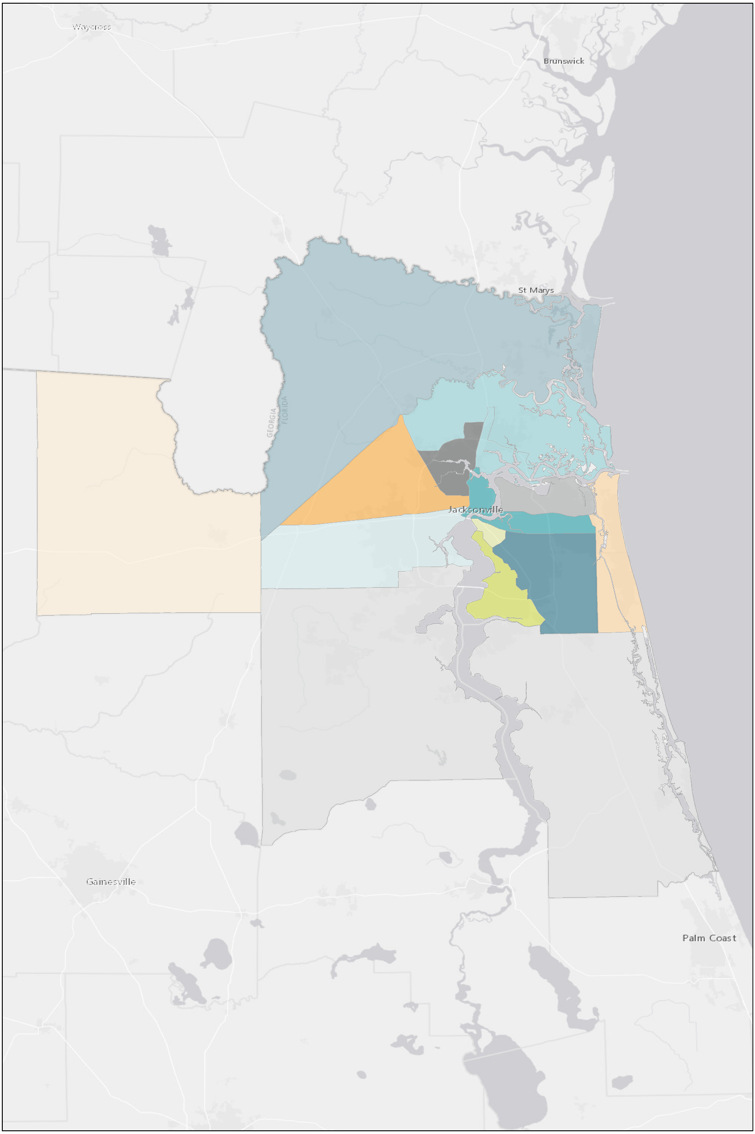
INDUSTRIAL REPORT | JACKSONVILLE | Q1 2025
Our Team
JAKE AMMON, CCIM
Director
Industrial and Office
Jake.Ammon@FranklinSt.com
P: 904.271.4123
KELLY ANTINI
Research Analyst
Kelly.Antini@FranklinSt.com
P: 813.839.7300
Nassau County
Northeast
ARLETTE PRICE
Senior Associate
Industrial and Office
Arlette.Price@FranklinSt.com
P: 904.243.6363
ALEX RAMOS
Business Data Analyst Alex.Ramos@FranklinSt.com
P: 813.839.7300
North Side
Ocean Way
West side
Downtown
COOPER FOLDS
Associate
Industrial and Office
Cooper.Folds@FranklinSt.com
P: 904.405.1806
Riverside
Butler Corridor
St Johns
Source: CoStar
Disclaimer:
Franklin Street, together with its subsidiaries or affiliates, reserves all rights contained in this report. This report is gathered from purported reliable multiple third-party and independent sources for the purposes of providing information to the public as a whole. It is not intended to reflect, nor does it represent, any warranties, representations or accuracies within any data or information and may, in fact, contain errors or incomplete information. Any views expressed in this report are subject to change with or without notice. Any advice provided to clients by Franklin Street may reflect different opinions based upon the unique and independent client circumstances to a given transaction or service. Franklin Street does not suggest, and expressly disclaims, reliance on investment or other business decisions made solely upon the information contained in this report.
https://franklinst.com/
Franklin Street Data & Research
2025 Franklin Street

Slide 13
ORLANDO
INDUSTRIAL REPORT
Q1 2025
Franklin Street Data & Research

Slide 14
INDUSTRIAL REPORT | ORLANDO | Q1 2025
Outlook
Orlando's industrial market is experiencing slow demand following its fastest two-year inventory expansion in history. According to CoStar, vacancy rates are near a decade-high and are expected to remain elevated through 2025, with most demand focused on spaces under 50,000 square feet, where availability is tightest. Leasing activity has dipped slightly from the previous year, and the average lease size has contracted by over 10%. Market participants have reported fewer large-space users looking to expand compared to two years ago, which has directly impacted demand. CoStar data also shows that Orlando has led the nation in availability for industrial buildings 500,000 square feet and larger for over a year. Slowing demand and an influx of new supply have already tempered rent growth, which has decelerated to 6.3%.
YOY Trends
Absorption & Deliveries
8.0%
Vacancy Rate
3.2M
Under Construction SF
$14.37
Market Rent/SF
175K
12 MO Net Absorption SF
Under Construction
Sales Volume
Franklin Street Data & Research
2025 Franklin Street

Slide 15
INDUSTRIAL REPORT | ORLANDO | Q1 2025
Market Asking Rent & Growth
Job Growth
Population Growth
Median Household Income & Growth
Franklin Street Data & Research
2025 Franklin Street

Slide 16
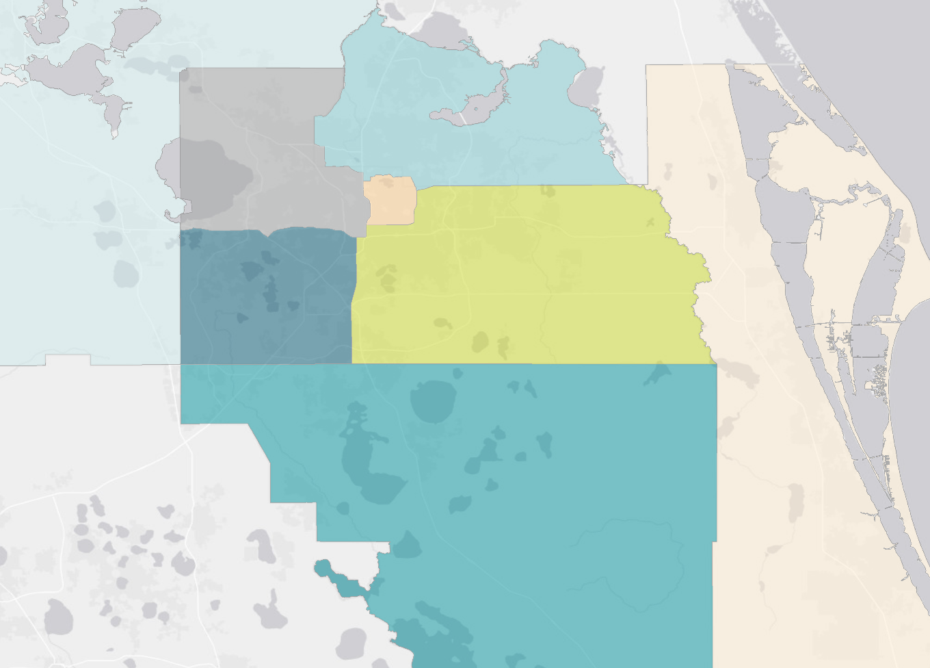
INDUSTRIAL REPORT | ORLANDO | Q1 2025
Our Team
SCOTT EDWARDS Director
Industrial Leasing Services
Scott.Edwards@FranklinSt.com
P: 407.458.5400
Seminole County
NW Orange
County
Lake County
KELLY ANTINI
Research Analyst
Kelly.Antini@FranklinSt.com
P: 813.839.7300
SW Orange
County
SE Orange County
Osceola County
ALEX RAMOS
Business Data Analyst Alex.Ramos@FranklinSt.com
P: 813.839.7300
Source: CoStar
Disclaimer:
Franklin Street, together with its subsidiaries or affiliates, reserves all rights contained in this report. This report is gathered from purported reliable multiple third-party and independent sources for the purposes of providing information to the public as a whole. It is not intended to reflect, nor does it represent, any warranties, representations or accuracies within any data or information and may, in fact, contain errors or incomplete information. Any views expressed in this report are subject to change with or without notice. Any advice provided to clients by Franklin Street may reflect different opinions based upon the unique and independent client circumstances to a given transaction or service. Franklin Street does not suggest, and expressly disclaims, reliance on investment or other business decisions made solely upon the information contained in this report.
https://franklinst.com/
Franklin Street Data & Research
2025 Franklin Street

Slide 17
TAMPA
INDUSTRIAL REPORT
Q1 2025
Franklin Street Data & Research

Slide 18
INDUSTRIAL REPORT | TAMPA | Q1 2025
Outlook
Tampa’s industrial market remains relatively well-positioned compared to other major metros, though recent challenges are beginning to emerge. According to CoStar, a wave of new development and a slowdown in large lease signings have pushed the vacancy rate to an eight-year high, placing pressure on rent growth. Asking rents have increased 4.2% year over year, but that’s a notable deceleration from the average 13% annual gains seen between 2021 and 2023. New supply remains a headwind, with much of the incoming space—70% of which is still available—expected to further elevate vacancy in the coming quarters. As seen in recent trends, higher vacancies often correspond with slower rent growth, a dynamic that could persist through the remainder of 2025.
YOY Trends
Absorption & Deliveries
7.0%
Vacancy Rate
2.3M
Under Construction SF
$12.04
Market Rent/SF
3.0M
12 MO Net Absorption SF
Under Construction
Sales Volume
Franklin Street Data & Research
2025 Franklin Street

Slide 19
INDUSTRIAL REPORT | TAMPA | Q1 2025
Market Asking Rent & Growth
Job Growth
Population Growth
Median Household Income & Growth
Franklin Street Data & Research
2025 Franklin Street

Slide 20
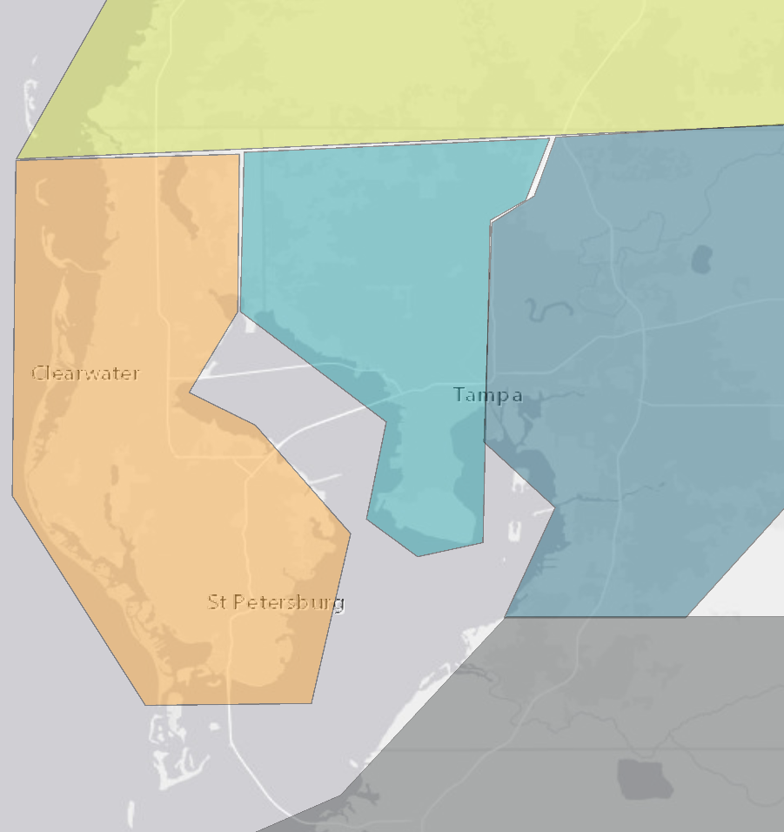
INDUSTRIAL REPORT | TAMPA | Q1 2025
Our Team
PAT KELLY
Senior Vice President
Industrial Investment Sales
Pat.Kelly@FranklinSt.com
P: 813.839.7300
ALEX RAMOS
Business Data Analyst Alex.Ramos@FranklinSt.com
P: 813.839.7300
Pasco-Hernando
Airport
BRAD HUTTON
Director
Industrial Leasing Services Brad.Hutton@FranklinSt.com
P: 813.839.7300
Pinellas
East Tampa
KELLY ANTINI
Research Analyst
Kelly.Antini@FranklinSt.com
P: 813.839.7300
Manatee
Source: CoStar. Data includes 20k s/ft and above buildings.
Disclaimer:
Franklin Street, together with its subsidiaries or affiliates, reserves all rights contained in this report. This report is gathered from purported reliable multiple third-party and independent sources for the purposes of providing information to the public as a whole. It is not intended to reflect, nor does it represent, any warranties, representations or accuracies within any data or information and may, in fact, contain errors or incomplete information. Any views expressed in this report are subject to change with or without notice. Any advice provided to clients by Franklin Street may reflect different opinions based upon the unique and independent client circumstances to a given transaction or service. Franklin Street does not suggest, and expressly disclaims, reliance on investment or other business decisions made solely upon the information contained in this report.
https://franklinst.com/
Franklin Street Data & Research
2025 Franklin Street

Slide 21
SOUTH FLORIDA
INDUSTRIAL REPORT
Q1 2025
Franklin Street Data & Research

Slide 22
INDUSTRIAL REPORT | SOUTH FLORIDA | Q1 2025
Outlook
South Florida’s industrial demand has tapered over the past year, driven in part by tenants reassessing their overall footprint in the region. Several major users—including UFP Industries, Essendant, Kuehne+Nagel, USPS, and Imperial Dade—have vacated spaces over 100,000 SF, contributing to a rise in market-wide vacancy. According to CoStar, the combination of softening tenant demand and elevated vacancies since 2023 has led to a notable slowdown in rent growth. Despite these headwinds, South Florida continues to serve as a critical logistics hub for its 6.1 million residents, bolstered by robust international infrastructure. CoStar highlights Miami International Airport’s top national ranking in international freight volume and the Port of Miami’s ability to accommodate Super Post Panamax vessels—key advantages that continue to attract global importers and exporters.
YOY Trends
Absorption & Deliveries
5.6%
Vacancy Rate
8.1M
Under Construction SF
$19.96
Market Rent/SF
(2.4M)
12 MO Net Absorption SF
Under Construction
Sales Volume
Franklin Street Data & Research
2025 Franklin Street

Slide 23
INDUSTRIAL REPORT | SOUTH FLORIDA | Q1 2025
Market Asking Rent & Growth
Job Growth
Population Growth
Median Household Income & Growth
Franklin Street Data & Research
2025 Franklin Street

Slide 24
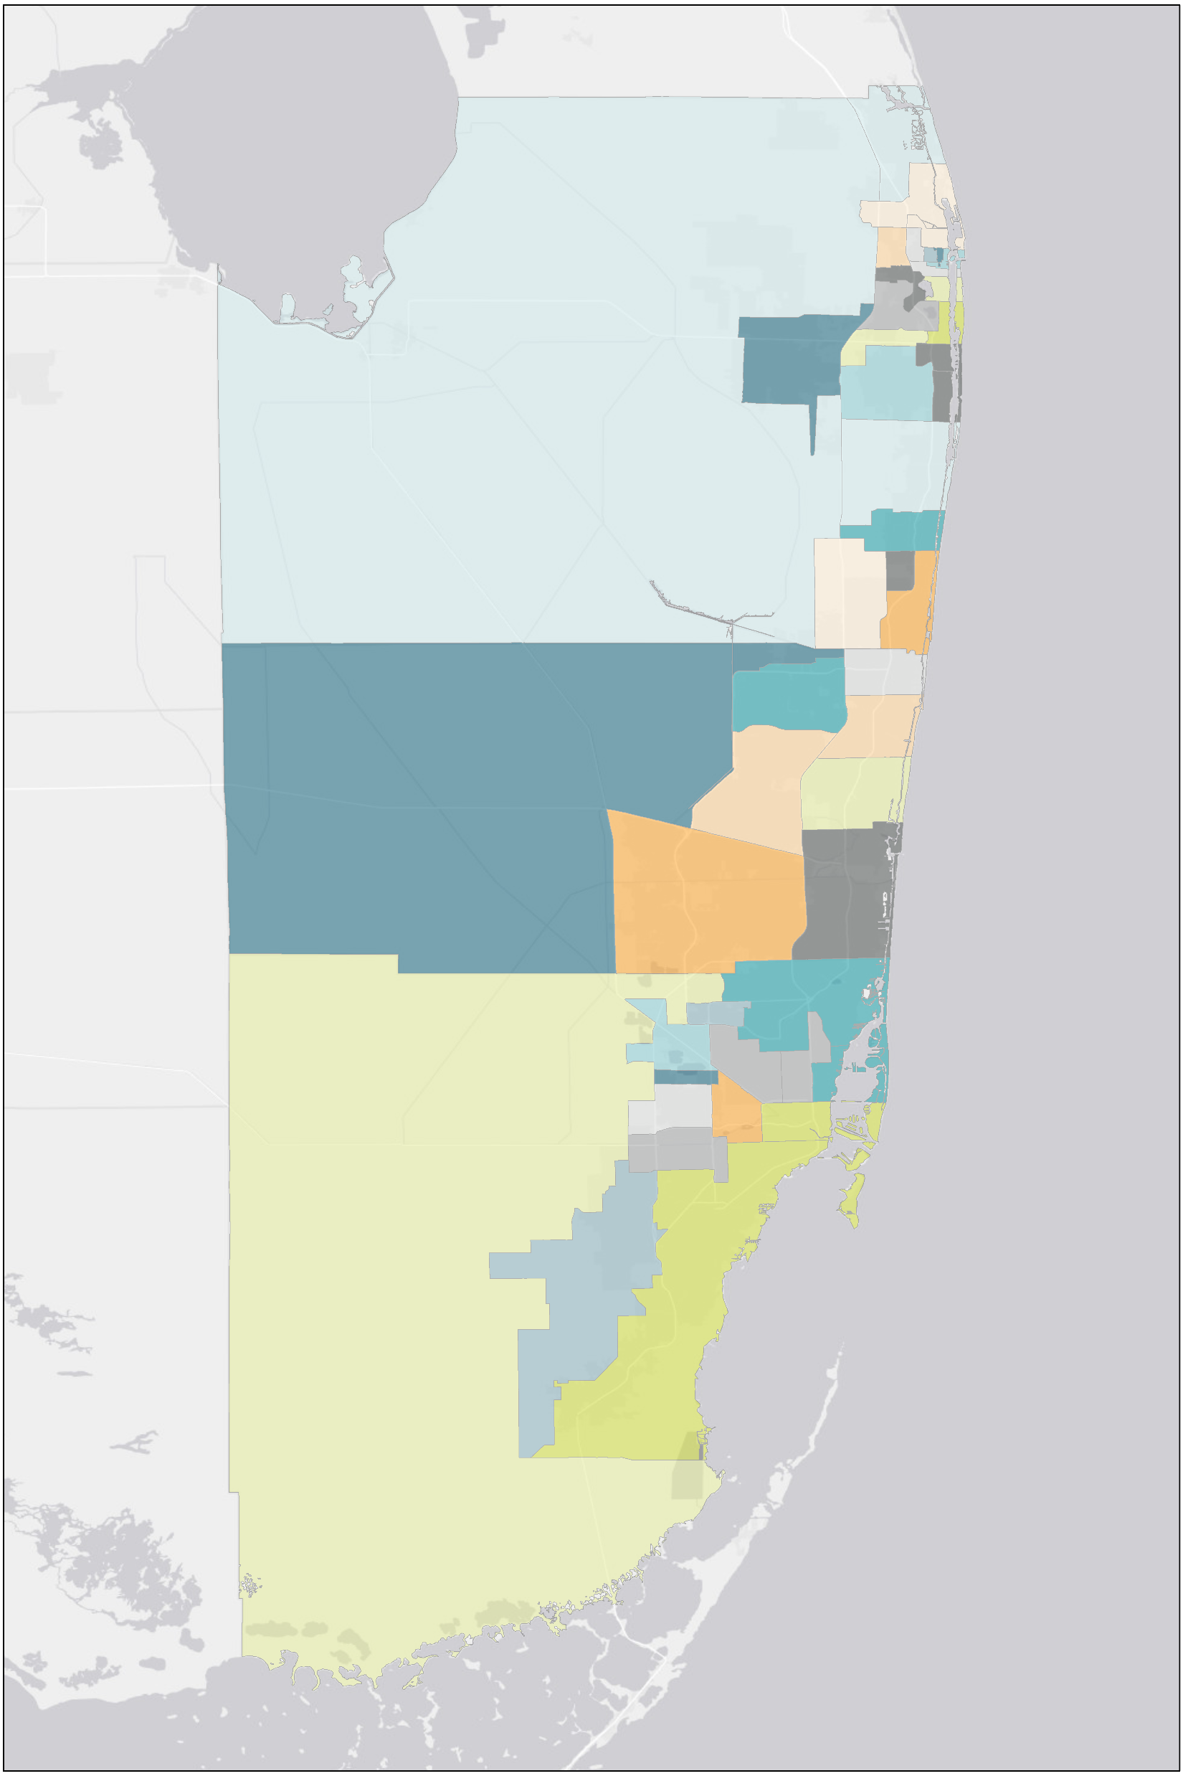
INDUSTRIAL REPORT | SOUTH FLORIDA | Q1 2025
Our Team
KELLY ANTINI
Research Analyst
Kelly.Antini@FranklinSt.com
P: 813.839.7300
Palm Beach Outlying
Pompano Beach
Outlying Broward
Central Broward
ALEX RAMOS
Business Data Analyst Alex.Ramos@FranklinSt.com
P: 813.839.7300
SW Broward
SE Broward
North Miami Beach
Airport West
Outlying Miami Dade
Hialeah
Source: CoStar
Disclaimer:
Franklin Street, together with its subsidiaries or affiliates, reserves all rights contained in this report. This report is gathered from purported reliable multiple third-party and independent sources for the purposes of providing information to the public as a whole. It is not intended to reflect, nor does it represent, any warranties, representations or accuracies within any data or information and may, in fact, contain errors or incomplete information. Any views expressed in this report are subject to change with or without notice. Any advice provided to clients by Franklin Street may reflect different opinions based upon the unique and independent client circumstances to a given transaction or service. Franklin Street does not suggest, and expressly disclaims, reliance on investment or other business decisions made solely upon the information contained in this report.
https://franklinst.com/
Franklin Street Data & Research
2025 Franklin Street

