Slide 1
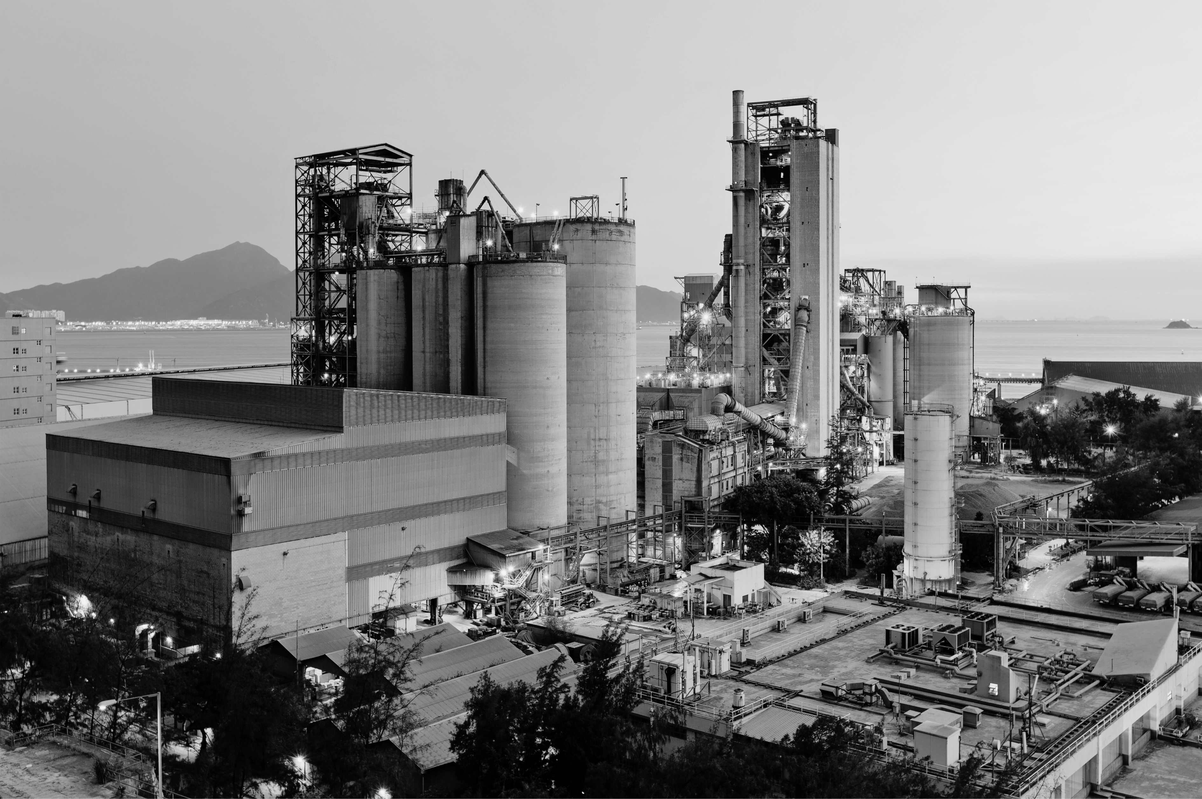



DALLAS
MULTIFAMILY REPORT
Q1 2025
Franklin Street Data & Research

Slide 2






MULTIFAMILY REPORT | DALLAS | Q1 2025
Outlook
The Dallas-Fort Worth multifamily market is gradually moving toward equilibrium following a year of record-breaking supply. According to CoStar, roughly 37,000 new units were delivered over the past year, outpacing renter demand, which totaled 27,000 units. However, the gap between supply and demand is beginning to narrow, supported by a cooling construction pipeline and steady leasing momentum through the first quarter of 2025. While the supply-demand imbalance has weighed on fundamentals, new development is starting to downshift. CoStar data shows construction starts have fallen to a decade-low, as elevated borrowing costs and softer property performance continue to deter developers from launching new projects.
YOY Trends
Absorption & Deliveries
11.6%
Vacancy Rate
34K
Under Construction Units
$1,566
Market Rent/Unit
27.5K
12 MO Net Absorption Units
Under Construction
Sales Volume
Franklin Street Data & Research
2025 Franklin Street

Slide 3
MULTIFAMILY REPORT | DALLAS | Q1 2025
Market Asking Rent & Growth
Job Growth
Population Growth
Median Household Income & Growth
Franklin Street Data & Research
2025 Franklin Street

Slide 4
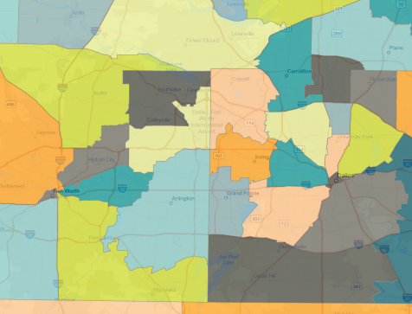

MULTIFAMILY REPORT | DALLAS | Q1 2025
Our Team
PATRICK STRAKE
Senior Director
Multifamily Investment Sales
Patrick.Strake@FranklinSt.com
P: 737.270.9785
Carrollton
North
Fort Worth
Northwest
Dallas
KELLY ANTINI
Research Analyst
Kelly.Antini@FranklinSt.com
P: 813.839.7300
Northwest
Fort Worth
East Dallas
North Richland
Hills
Irving
Uptown
Arlington
Oak Cliff
ALEX RAMOS
Business Data Analyst Alex.Ramos@FranklinSt.com
P: 813.839.7300
Southeast
Fort Worth
Source: CoStar
Disclaimer:
Franklin Street, together with its subsidiaries or affiliates, reserves all rights contained in this report. This report is gathered from purported reliable multiple third-party and independent sources for the purposes of providing information to the public as a whole. It is not intended to reflect, nor does it represent, any warranties, representations or accuracies within any data or information and may, in fact, contain errors or incomplete information. Any views expressed in this report are subject to change with or without notice. Any advice provided to clients by Franklin Street may reflect different opinions based upon the unique and independent client circumstances to a given transaction or service. Franklin Street does not suggest, and expressly disclaims, reliance on investment or other business decisions made solely upon the information contained in this report.
https://franklinst.com/
Franklin Street Data & Research
2025 Franklin Street

Slide 5
SAN ANTONIO
MULTIFAMILY REPORT
Q1 2025
Franklin Street Data & Research

Slide 6
MULTIFAMILY REPORT | SAN ANTONIO | Q1 2025
Outlook
San Antonio is in the midst of its largest multifamily development wave on record, with thousands of new units continuing to come online in 2025—even as the pace of deliveries begins to slow. According to CoStar, the volume of new properties hitting the market is expected to place downward pressure on key performance indicators, despite a seasonal uptick in leasing activity anticipated during the spring and summer months. Leasing has remained positive over the past year and into early 2025, but net absorption has consistently lagged behind new supply. CoStar projects that vacancies will likely stay in the double digits over the next eight quarters as the remaining pipeline is delivered, continuing to challenge overall market balance.
YOY Trends
Absorption & Deliveries
15%
Vacancy Rate
5.7K
Under Construction Units
$1,286
Market Rent/Unit
6.7K
12 MO Net Absorption Units
Under Construction
Sales Volume
Franklin Street Data & Research
2025 Franklin Street

Slide 7
MULTIFAMILY REPORT | SAN ANTONIO | Q1 2025
Market Asking Rent & Growth
Job Growth
Population Growth
Median Household Income & Growth
Franklin Street Data & Research
2025 Franklin Street

Slide 8
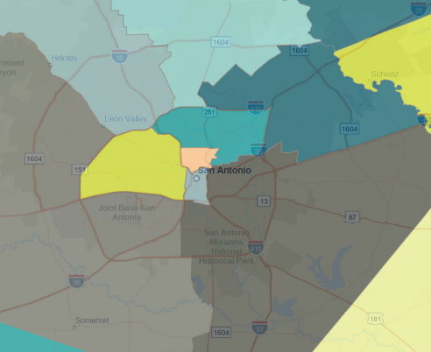
MULTIFAMILY REPORT | SAN ANTONIO | Q1 2025
Our Team
North San Antonio
PATRICK STRAKE
Senior Director
Multifamily Investment Sales
Patrick.Strake@FranklinSt.com
P: 737.270.9785
Northwest
San Antonio
Northeast
San Antonio
Far West
San Antonio
KELLY ANTINI
Research Analyst
Kelly.Antini@FranklinSt.com
P: 813.839.7300
Downtown
Southeast San Antonio
Southwest San Antonio
ALEX RAMOS
Business Data Analyst Alex.Ramos@FranklinSt.com
P: 813.839.7300
Source: CoStar
Disclaimer:
Franklin Street, together with its subsidiaries or affiliates, reserves all rights contained in this report. This report is gathered from purported reliable multiple third-party and independent sources for the purposes of providing information to the public as a whole. It is not intended to reflect, nor does it represent, any warranties, representations or accuracies within any data or information and may, in fact, contain errors or incomplete information. Any views expressed in this report are subject to change with or without notice. Any advice provided to clients by Franklin Street may reflect different opinions based upon the unique and independent client circumstances to a given transaction or service. Franklin Street does not suggest, and expressly disclaims, reliance on investment or other business decisions made solely upon the information contained in this report.
https://franklinst.com/
Franklin Street Data & Research
2025 Franklin Street

Slide 9
AUSTIN
MULTIFAMILY REPORT
Q1 2025
Franklin Street Data & Research

Slide 10
MULTIFAMILY REPORT | AUSTIN | Q1 2025
Outlook
Austin’s multifamily market appears to be shifting momentum in 2025, with new delivery volumes starting to slow down. According to CoStar, the first quarter of the year marked a significant shift, with net absorption outpacing new supply for the first time in over three years. This improvement was supported by one of the strongest first quarters in Austin’s history, with nearly 4,800 units absorbed—ranking fourth highest nationally, per CoStar. Despite this progress, Austin still holds the highest vacancy rate among major U.S. markets, a lingering consequence of years of supply outstripping demand. While 2024’s record-setting pace of absorption may not be repeated, demand is expected to remain strong. The market is currently on track for approximately 15,000 units of absorption this year—Austin’s third-highest annual total ever and the highest in the nation relative to inventory size.
YOY Trends
Absorption & Deliveries
15%
Vacancy Rate
21K
Under Construction Units
$1,592
Market Rent/Unit
21K
12 MO Net Absorption Units
Under Construction
Sales Volume
Franklin Street Data & Research
2025 Franklin Street

Slide 11
MULTIFAMILY REPORT | AUSTIN | Q1 2025
Market Asking Rent & Growth
Job Growth
Population Growth
Median Household Income & Growth
Franklin Street Data & Research
2025 Franklin Street

Slide 12
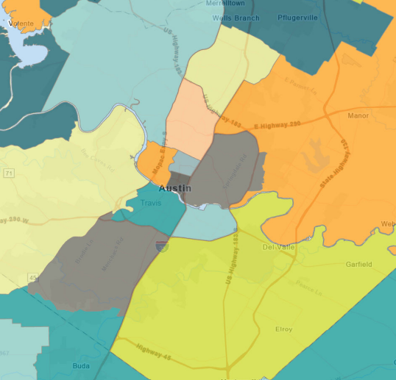
MULTIFAMILY REPORT | AUSTIN | Q1 2025
Our Team
PATRICK STRAKE
Senior Director
Multifamily Investment Sales
Patrick.Strake@FranklinSt.com
P: 737.270.9785
Northwest Austin
North Austin
Midtown
Northeast Austin
KELLY ANTINI
Research Analyst
Kelly.Antini@FranklinSt.com
P: 813.839.7300
Southwest Austin
East Austin
South Central
Austin
Riverside
ALEX RAMOS
Business Data Analyst Alex.Ramos@FranklinSt.com
P: 813.839.7300
South Austin
Southeast Austin
Source: CoStar
Disclaimer:
Franklin Street, together with its subsidiaries or affiliates, reserves all rights contained in this report. This report is gathered from purported reliable multiple third-party and independent sources for the purposes of providing information to the public as a whole. It is not intended to reflect, nor does it represent, any warranties, representations or accuracies within any data or information and may, in fact, contain errors or incomplete information. Any views expressed in this report are subject to change with or without notice. Any advice provided to clients by Franklin Street may reflect different opinions based upon the unique and independent client circumstances to a given transaction or service. Franklin Street does not suggest, and expressly disclaims, reliance on investment or other business decisions made solely upon the information contained in this report.
https://franklinst.com/
Franklin Street Data & Research
2025 Franklin Street

Slide 13
NASHVILLE
MULTIFAMILY REPORT
Q1 2025
Franklin Street Data & Research

Slide 14
MULTIFAMILY REPORT | NASHVILLE | Q1 2025
Outlook
The Nashville multifamily market demonstrated strong resilience in Q1 2025, following a record-setting 2024 in which net absorption nearly reached 11,000 units. While occupancy has softened slightly to 90%—with a modest dip still expected—the sharp 41% drop in new deliveries from 2024 levels should help stabilize conditions. Asking rents averaged $1,710 and are projected to grow by a modest 2.1% in 2025. Renter demand remained concentrated in key submarkets such as Downtown and Southeast Nashville, which led in net absorption. Economically, Nashville continues to outperform with a low unemployment rate of 2.9%, reinforcing the market’s long-term fundamentals. Investment volume topped $1 billion in 2024, though the average price per unit fell roughly 25%, opening doors for value-driven investors. With a reduced construction pipeline and solid economic footing, the market is positioned to absorb lingering vacancies and support steady rent growth through the remainder of the year.
YOY Trends
Absorption & Deliveries
11.4%
Vacancy Rate
14.7K
Under Construction Units
$1,711
Market Rent/Unit
10K
12 MO Net Absorption Units
Under Construction
Sales Volume
Franklin Street Data & Research
2025 Franklin Street

Slide 15
MULTIFAMILY REPORT | NASHVILLE | Q1 2025
Market Asking Rent & Growth
Job Growth
Population Growth
Median Household Income & Growth
Franklin Street Data & Research
2025 Franklin Street

Slide 16
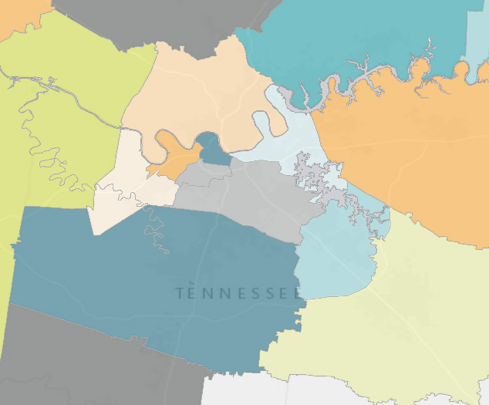
MULTIFAMILY REPORT | NASHVILLE | Q1 2025
Our Team
JONATHAN HAWKS
Senior Director
Multifamily Investment Sales
Jonathan.Hawks@FranklinSt.com
P: 706.372.4177
Sumner County
Madison/
Rivergate
Downtown
Nashville
Donelson
KELLY ANTINI
Research Analyst
Kelly.Antini@FranklinSt.com
P: 813.839.7300
Wilson County
Bellevue
SE Nashville
Smyrna/
La Vergne
Williamson County
ALEX RAMOS
Business Data Analyst Alex.Ramos@FranklinSt.com
P: 813.839.7300
Murfreesboro
Source: CoStar
Disclaimer:
Franklin Street, together with its subsidiaries or affiliates, reserves all rights contained in this report. This report is gathered from purported reliable multiple third-party and independent sources for the purposes of providing information to the public as a whole. It is not intended to reflect, nor does it represent, any warranties, representations or accuracies within any data or information and may, in fact, contain errors or incomplete information. Any views expressed in this report are subject to change with or without notice. Any advice provided to clients by Franklin Street may reflect different opinions based upon the unique and independent client circumstances to a given transaction or service. Franklin Street does not suggest, and expressly disclaims, reliance on investment or other business decisions made solely upon the information contained in this report.
https://franklinst.com/
Franklin Street Data & Research
2025 Franklin Street

Slide 17
ATLANTA
MULTIFAMILY REPORT
Q1 2025
Franklin Street Data & Research

Slide 18
MULTIFAMILY REPORT | ATLANTA | Q1 2025
Outlook
Demand has returned to Atlanta’s multifamily market, but the effects of a record-setting supply wave continue to weigh on fundamentals. According to CoStar, while net absorption has turned positive, vacancy rates remain elevated and rents are still declining in many segments of the market. The metro has now logged nine consecutive quarters of positive absorption, a turnaround from the flat to negative demand seen in 2022. Much of this recent activity has been concentrated in 4 & 5 Star properties, while demand for lower- to mid-tier units remains muted due to ongoing inflationary pressures. Looking ahead, Atlanta’s overall vacancy is expected to stay above its 10-year average for the next few years, as new deliveries slow and the market gradually absorbs the surplus supply.
YOY Trends
Absorption & Deliveries
12.5%
Vacancy Rate
17K
Under Construction Units
$1,657
Market Rent/Unit
20.6K
12 MO Net Absorption Units
Under Construction
Sales Volume
Franklin Street Data & Research
2025 Franklin Street

Slide 19
MULTIFAMILY REPORT | ATLANTA | Q1 2025
Market Asking Rent & Growth
Job Growth
Population Growth
Median Household Income & Growth
Franklin Street Data & Research
2025 Franklin Street

Slide 20
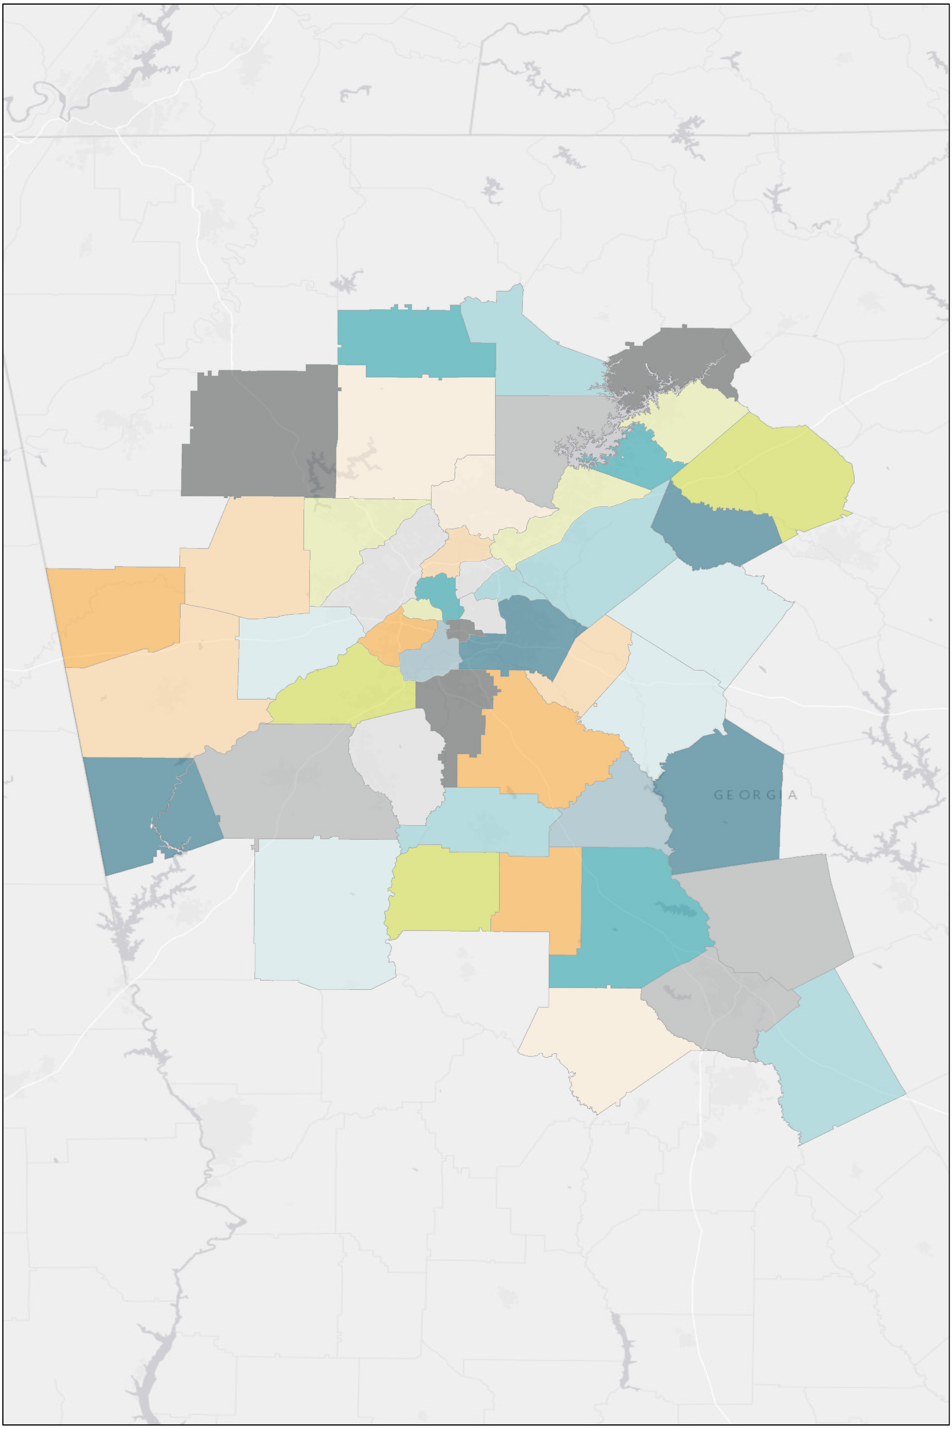
MULTIFAMILY REPORT | ATLANTA | Q1 2025
Our Team
JOHN MCCALLA
Managing Director
Multifamily Investment Sales
John.McCalla@FranklinSt.com
P: 470.832.1250
ALEX RAMOS
Business Data Analyst Alex.Ramos@FranklinSt.com
P: 813.839.7300
North
Gwinnett
North Fulton
Kennesaw
Sandy Springs/
Dunwoody
Cumberland/
Galleria
Outlying Gwinnett County
MASON TAYLOR
Senior Director
Multifamily Investment Sales Mason.Taylor@FranklinSt.com
P: 470.832.1250
Buckhead
North Lake
Midtown
Atlanta
South
Atlanta
Southeast DeKalb
KELLY ANTINI
Research Analyst
Kelly.Antini@FranklinSt.com
P: 813.839.7300
Clayton
County
Source: CoStar
Disclaimer:
Franklin Street, together with its subsidiaries or affiliates, reserves all rights contained in this report. This report is gathered from purported reliable multiple third-party and independent sources for the purposes of providing information to the public as a whole. It is not intended to reflect, nor does it represent, any warranties, representations or accuracies within any data or information and may, in fact, contain errors or incomplete information. Any views expressed in this report are subject to change with or without notice. Any advice provided to clients by Franklin Street may reflect different opinions based upon the unique and independent client circumstances to a given transaction or service. Franklin Street does not suggest, and expressly disclaims, reliance on investment or other business decisions made solely upon the information contained in this report.
https://franklinst.com/
Franklin Street Data & Research
2025 Franklin Street

Slide 21
JACKSONVILLE
MULTIFAMILY REPORT
Q1 2025
Franklin Street Data & Research

Slide 22
MULTIFAMILY REPORT | JACKSONVILLE | Q1 2025
Outlook
Renter demand in Jacksonville's multifamily market has remained strong, with absorption increasing quarter over quarter, largely driven by the region’s sustained population growth. Demand has been particularly robust in the Southside and Saint Augustine areas, which together accounted for approximately 60% of all absorption over the past year. Notably, no submarkets reported negative absorption during this period. Despite strong demand, CoStar reports that the overall vacancy rate in Jacksonville's multifamily market remains elevated. Nearly 80% of newly delivered units in the past year were concentrated in higher-tier 4 & 5 Star properties. However, with the development pipeline slowing for several quarters and construction starts down more than 65% year over year, vacancy is expected to decline gradually over time.
YOY Trends
Absorption & Deliveries
13.5%
Vacancy Rate
3.2K
Under Construction Units
$1,521
Market Rent/Unit
8.0K
12 MO Net Absorption Units
Under Construction
Sales Volume
Franklin Street Data & Research
2025 Franklin Street

Slide 23
MULTIFAMILY REPORT | JACKSONVILLE | Q1 2025
Market Asking Rent & Growth
Job Growth
Population Growth
Median Household Income & Growth
Franklin Street Data & Research
2025 Franklin Street

Slide 24
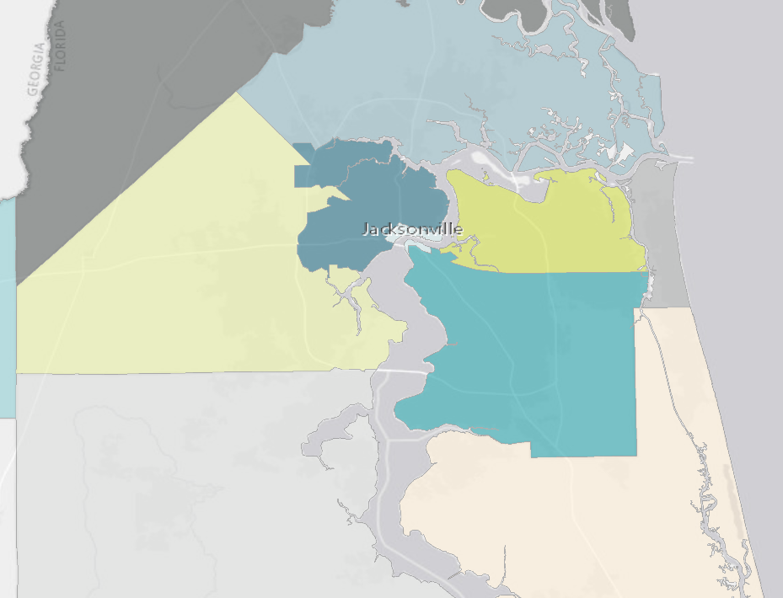
MULTIFAMILY REPORT | JACKSONVILLE | Q1 2025
Our Team
KELLY ANTINI
Research Analyst
Kelly.Antini@FranklinSt.com
P: 813.839.7300
Nassau County
North Side
Central Jacksonville
ALEX RAMOS
Business Data Analyst Alex.Ramos@FranklinSt.com
P: 813.839.7300
Arlington
Beaches
West side
Southside
Orange Park
St Augustine
Source: CoStar
Disclaimer:
Franklin Street, together with its subsidiaries or affiliates, reserves all rights contained in this report. This report is gathered from purported reliable multiple third-party and independent sources for the purposes of providing information to the public as a whole. It is not intended to reflect, nor does it represent, any warranties, representations or accuracies within any data or information and may, in fact, contain errors or incomplete information. Any views expressed in this report are subject to change with or without notice. Any advice provided to clients by Franklin Street may reflect different opinions based upon the unique and independent client circumstances to a given transaction or service. Franklin Street does not suggest, and expressly disclaims, reliance on investment or other business decisions made solely upon the information contained in this report.
https://franklinst.com/
Franklin Street Data & Research
2025 Franklin Street

Slide 25
ORLANDO
MULTIFAMILY REPORT
Q1 2025
Franklin Street Data & Research

Slide 26
MULTIFAMILY REPORT | ORLANDO | Q1 2025
Outlook
Renter demand surged in Orlando throughout 2024, with annual absorption surpassing the combined total of the previous two years. That strength has continued into 2025, driven largely by top-tier product. According to CoStar, 4 & 5 Star properties accounted for nearly 90% of all units absorbed over the past 12 months, reflecting a clear renter preference for higher-quality assets. Despite elevated vacancy due to a prolonged development cycle—more than 55,000 new units have delivered over the past five years—supply and demand fundamentals are nearing equilibrium for the first time since 2017. CoStar notes that while risks remain across the national multifamily landscape, Orlando is better positioned than many peer markets, supported by its diversified local economy and the stabilizing influence of tourism-related GDP.
YOY Trends
Absorption & Deliveries
10%
Vacancy Rate
14.4K
Under Construction Units
$1,806
Market Rent/Unit
13K
12 MO Net Absorption Units
Under Construction
Sales Volume
Franklin Street Data & Research
2025 Franklin Street

Slide 27
MULTIFAMILY REPORT | ORLANDO | Q1 2025
Market Asking Rent & Growth
Job Growth
Population Growth
Median Household Income & Growth
Franklin Street Data & Research
2025 Franklin Street

Slide 28
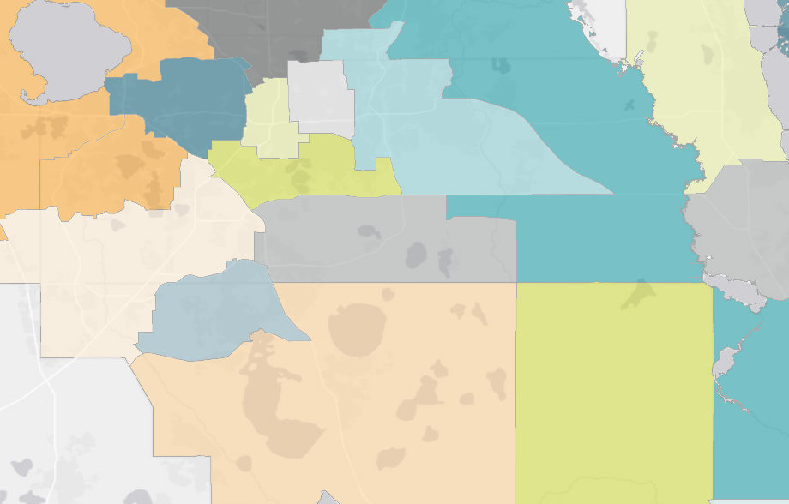
MULTIFAMILY REPORT | ORLANDO | Q1 2025
Our Team
DARRON KATTAN
Managing Director
Multifamily Investment Sales
Darron.Kattan@FranklinSt.com
P: 813.839.7300
ALEX RAMOS
Business Data Analyst Alex.Ramos@FranklinSt.com
P: 813.839.7300
North Orlando
West
Orlando
Eastside
Downtown
Orlando
East Orlando
South Orlando
ZACHARY AMES
Managing Director
Institutional Services Group
Zachary.Ames@FranklinSt.com
P: 813.839.7300
I Drive Orlando
East Outlying
SW Orlando
KELLY ANTINI
Research Analyst
Kelly.Antini@FranklinSt.com
P: 813.839.7300
Seminole County
Source: CoStar
Disclaimer:
Franklin Street, together with its subsidiaries or affiliates, reserves all rights contained in this report. This report is gathered from purported reliable multiple third-party and independent sources for the purposes of providing information to the public as a whole. It is not intended to reflect, nor does it represent, any warranties, representations or accuracies within any data or information and may, in fact, contain errors or incomplete information. Any views expressed in this report are subject to change with or without notice. Any advice provided to clients by Franklin Street may reflect different opinions based upon the unique and independent client circumstances to a given transaction or service. Franklin Street does not suggest, and expressly disclaims, reliance on investment or other business decisions made solely upon the information contained in this report.
https://franklinst.com/
Franklin Street Data & Research
2025 Franklin Street

Slide 29
TAMPA
MULTIFAMILY REPORT
Q1 2025
Franklin Street Data & Research

Slide 30
MULTIFAMILY REPORT | TAMPA | Q1 2025
Outlook
Tampa’s multifamily fundamentals have strengthened notably in recent quarters. For the first time since 2021, net absorption has outpaced new completions over the trailing 12 months, leading to a decline in the market’s overall vacancy rate. According to CoStar, this shift has given landlords renewed pricing power, resulting in two consecutive quarters of positive rent growth. Looking ahead, the construction pipeline is expected to remain well below recent highs. CoStar reports that approximately 11,000 units are currently under construction—down significantly from nearly 18,000 at the beginning of 2024. With renter demand expected to hold steady and fewer new deliveries entering the market, vacancy is projected to decline further, positioning annual rent growth to accelerate—particularly in submarkets facing minimal new competition.
YOY Trends
Absorption & Deliveries
9.5%
Vacancy Rate
11.5K
Under Construction Units
$1,852
Market Rent/Unit
11K
12 MO Net Absorption Units
Under Construction
Sales Volume
Franklin Street Data & Research
2025 Franklin Street

Slide 31
MULTIFAMILY REPORT | TAMPA | Q1 2025
Market Asking Rent & Growth
Job Growth
Population Growth
Median Household Income & Growth
Franklin Street Data & Research
2025 Franklin Street

Slide 32
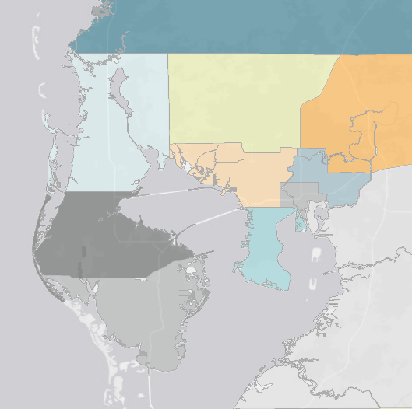
MULTIFAMILY REPORT | TAMPA | Q1 2025
Our Team
Pasco County
DARRON KATTAN
Managing Director
Multifamily Investment Sales
Darron.Kattan@FranklinSt.com
P: 813.839.7300
KELLY ANTINI
Research Analyst
Kelly.Antini@FranklinSt.com
P: 813.839.7300
NW Tampa
North Tampa
North
Pinellas
ZACHARY AMES
Managing Director
Institutional Services Group
Zachary.Ames@FranklinSt.com
P: 813.839.7300
ALEX RAMOS
Business Data Analyst Alex.Ramos@FranklinSt.com
P: 813.839.7300
West
Tampa
East Tampa
Downtown Tampa
Central Pinellas
South Tampa
AVERY JORDAN
Senior Director
Private Client Group
Avery.Jordan@FranklinSt.com
P: 813.839.7300
South
Pinellas
SE Tampa
Source: CoStar
Disclaimer:
Franklin Street, together with its subsidiaries or affiliates, reserves all rights contained in this report. This report is gathered from purported reliable multiple third-party and independent sources for the purposes of providing information to the public as a whole. It is not intended to reflect, nor does it represent, any warranties, representations or accuracies within any data or information and may, in fact, contain errors or incomplete information. Any views expressed in this report are subject to change with or without notice. Any advice provided to clients by Franklin Street may reflect different opinions based upon the unique and independent client circumstances to a given transaction or service. Franklin Street does not suggest, and expressly disclaims, reliance on investment or other business decisions made solely upon the information contained in this report.
https://franklinst.com/
Franklin Street Data & Research
2025 Franklin Street

Slide 33
SOUTH FLORIDA
MULTIFAMILY REPORT
Q1 2025
Franklin Street Data & Research

Slide 34
MULTIFAMILY REPORT | SOUTH FLORIDA | Q1 2025
Outlook
Apartment demand in South Florida has strengthened over the past year, supported by a steady flow of newly delivered units and rising interest in luxury rentals. According to CoStar, luxury apartment demand remained strong in Q1 2025, contributing to four consecutive quarters of net absorption exceeding the region’s 10-year average. While leasing activity hasn’t returned to the peaks of 2021, it continues to show consistent momentum. Still, affordability challenges and a sizable supply pipeline are weighing on near-term fundamentals. CoStar notes that these headwinds have kept annual rent growth subdued at just 0.5%—well below the 10-year average of 3.7%. Until the supply wave eases and affordability pressures moderate, South Florida’s rent growth is likely to remain tempered despite steady demand.
YOY Trends
Absorption & Deliveries
7.0%
Vacancy Rate
38K
Under Construction Units
$2,433
Market Rent/Unit
15K
12 MO Net Absorption Units
Under Construction
Sales Volume
Franklin Street Data & Research
2025 Franklin Street

Slide 35
MULTIFAMILY REPORT | SOUTH FLORIDA | Q1 2025
Market Asking Rent & Growth
Job Growth
Population Growth
Median Household Income & Growth
Franklin Street Data & Research
2025 Franklin Street

Slide 36
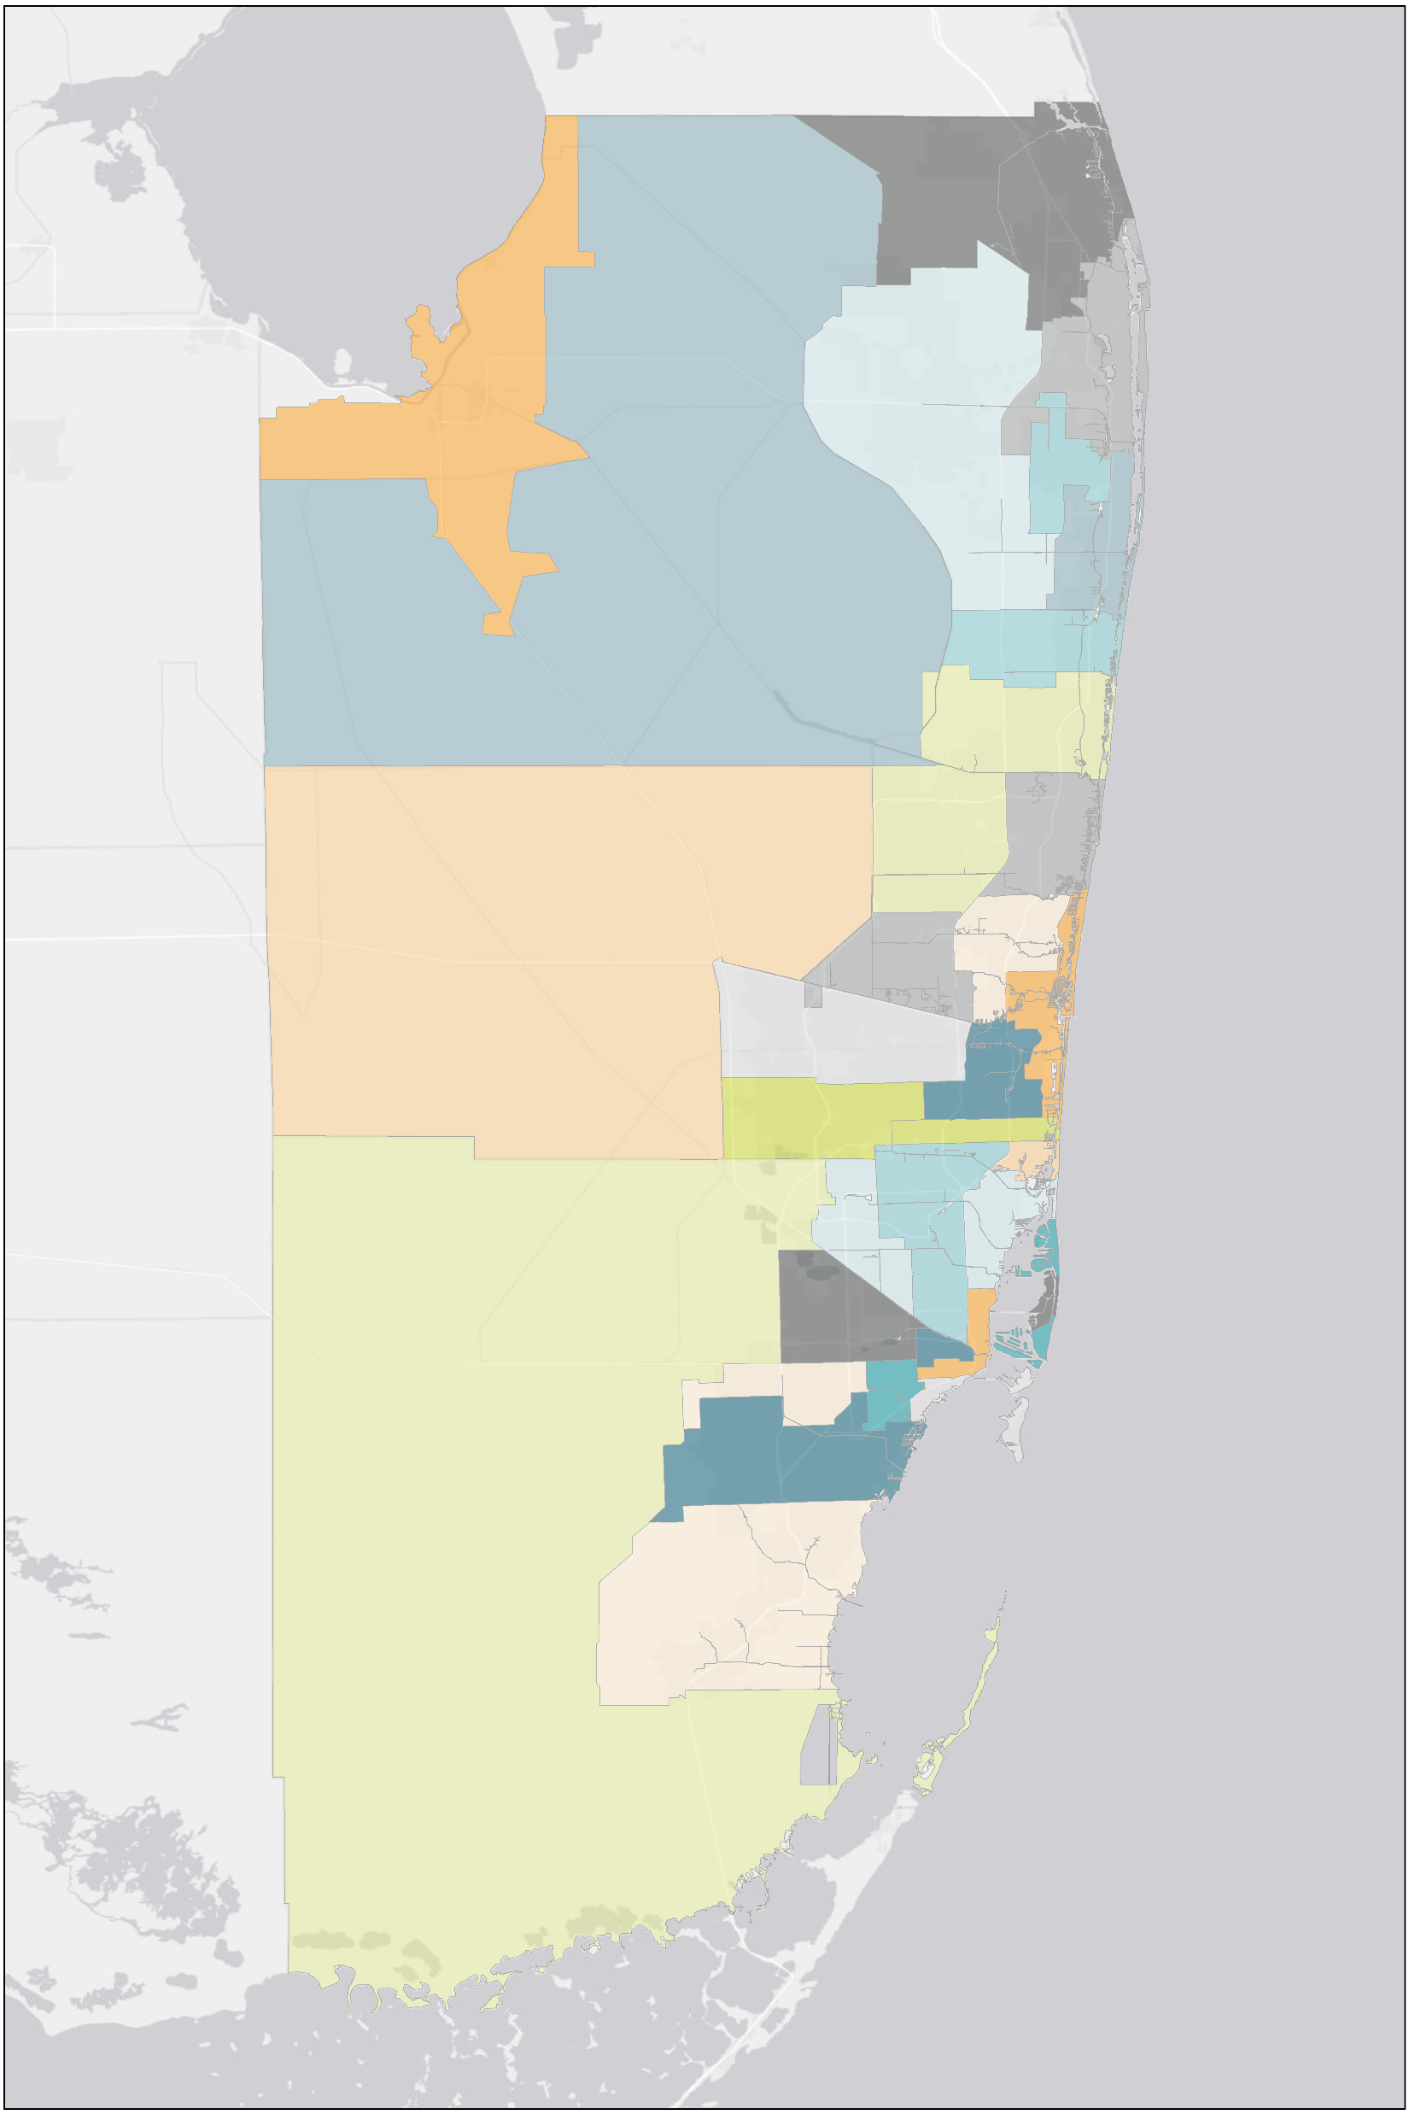
MULTIFAMILY REPORT | SOUTH FLORIDA | Q1 2025
Our Team
GREGORY MATUS
Senior Vice President
Multifamily Investment Sales
Gregory.Matus@FranklinSt.com
P: 954.640.1100
ALEX RAMOS
Business Data Analyst Alex.Ramos@FranklinSt.com
P: 813.839.7300
Boynton Beach
Boca Raton
DAN DRATCH
Regional Managing Director
Multifamily Investment Sales
Dan.Dratch@FranklinSt.com
P: 954.640.1100
Coral Springs
Pompano Beach
Plantation/
Sunrise
Central Fort
Lauderdale
KELLY ANTINI
Research Analyst
Kelly.Antini@FranklinSt.com
P: 813.839.7300
Pembroke Pines
Miami
Gardens
North Miami Beach
Miami Springs/
Doral
Downtown
Miami
Source: CoStar
Disclaimer:
Franklin Street, together with its subsidiaries or affiliates, reserves all rights contained in this report. This report is gathered from purported reliable multiple third-party and independent sources for the purposes of providing information to the public as a whole. It is not intended to reflect, nor does it represent, any warranties, representations or accuracies within any data or information and may, in fact, contain errors or incomplete information. Any views expressed in this report are subject to change with or without notice. Any advice provided to clients by Franklin Street may reflect different opinions based upon the unique and independent client circumstances to a given transaction or service. Franklin Street does not suggest, and expressly disclaims, reliance on investment or other business decisions made solely upon the information contained in this report.
https://franklinst.com/
Franklin Street Data & Research
2025 Franklin Street

